Slide 1
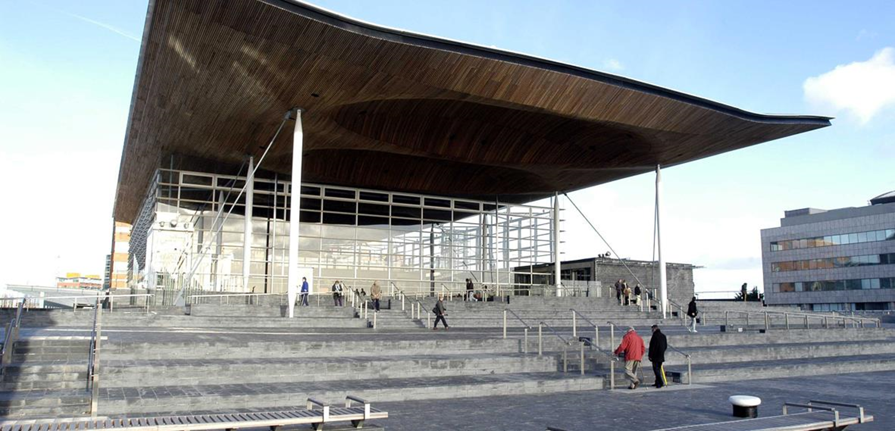

Slide 2
Ice breaker
What makes a good citizen?
Notes:
Cyfeirio at yr eirfa allweddol, moesol, gwybodus, cynaliadwy

Slide 3
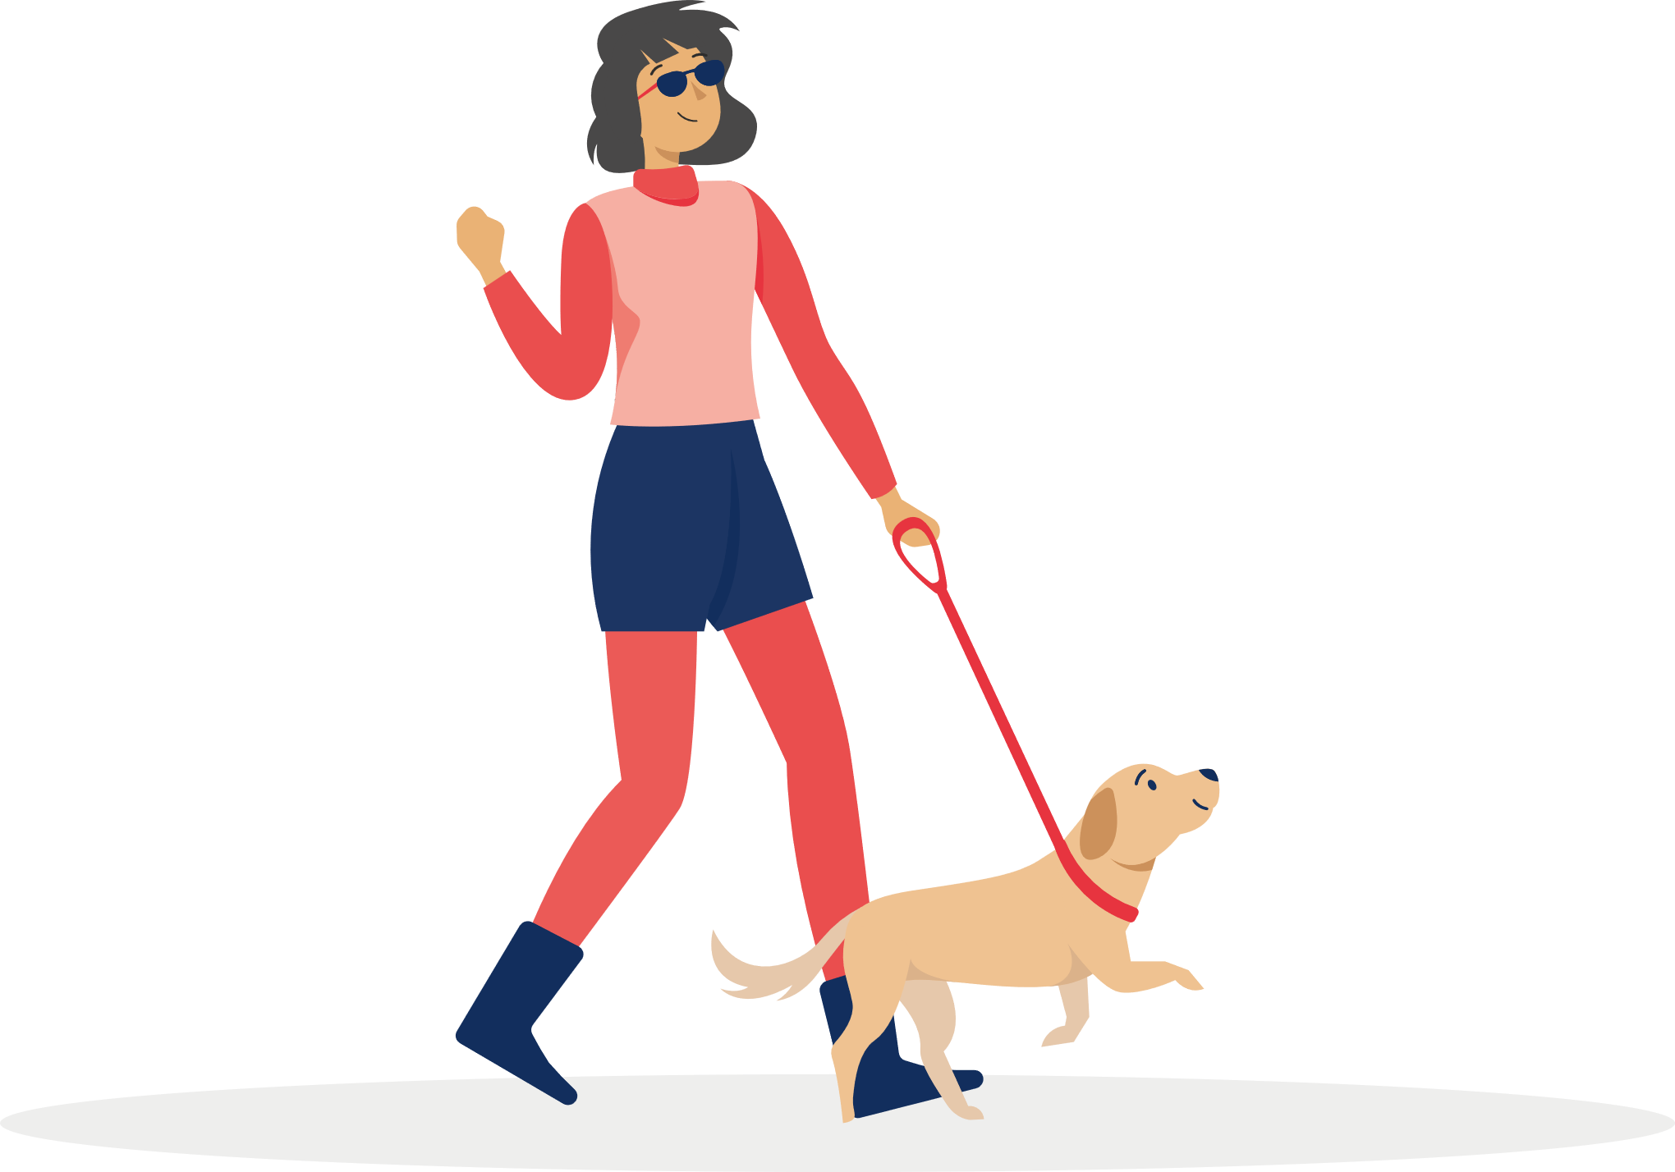
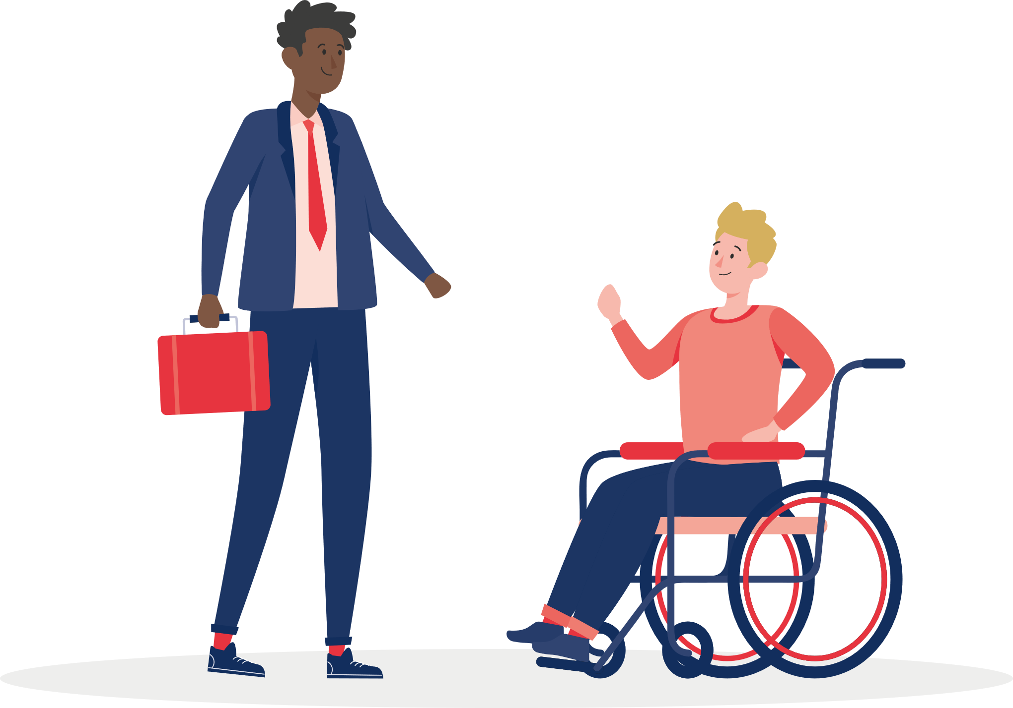
How then are you going to operate?
Possible model…..
Senedd (Welsh Parliament)
Welsh Youth Parliament

Slide 5
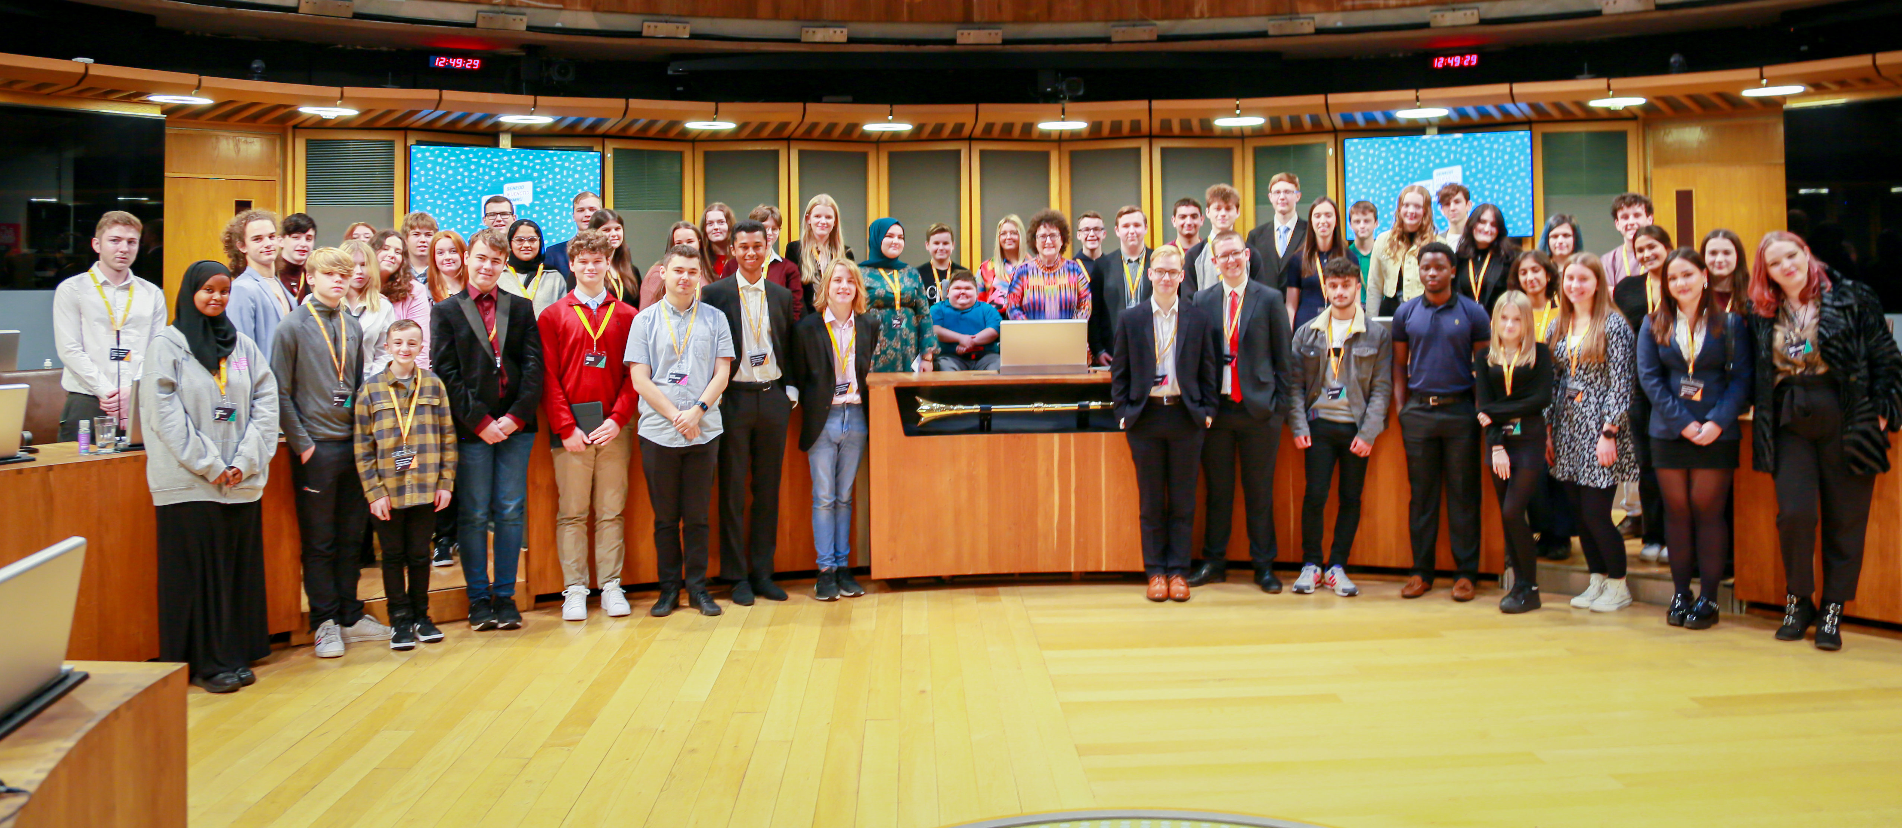
Welsh Youth Parliament
Notes:
The Welsh Youth Parliament was created in 2018 as a direct result of calls from the UN to have a platform in Wales for young people to have their voices heard. There are 60 young members aged 11-18 that hold the government to account on behalf of the young people of Wales.

Slide 6
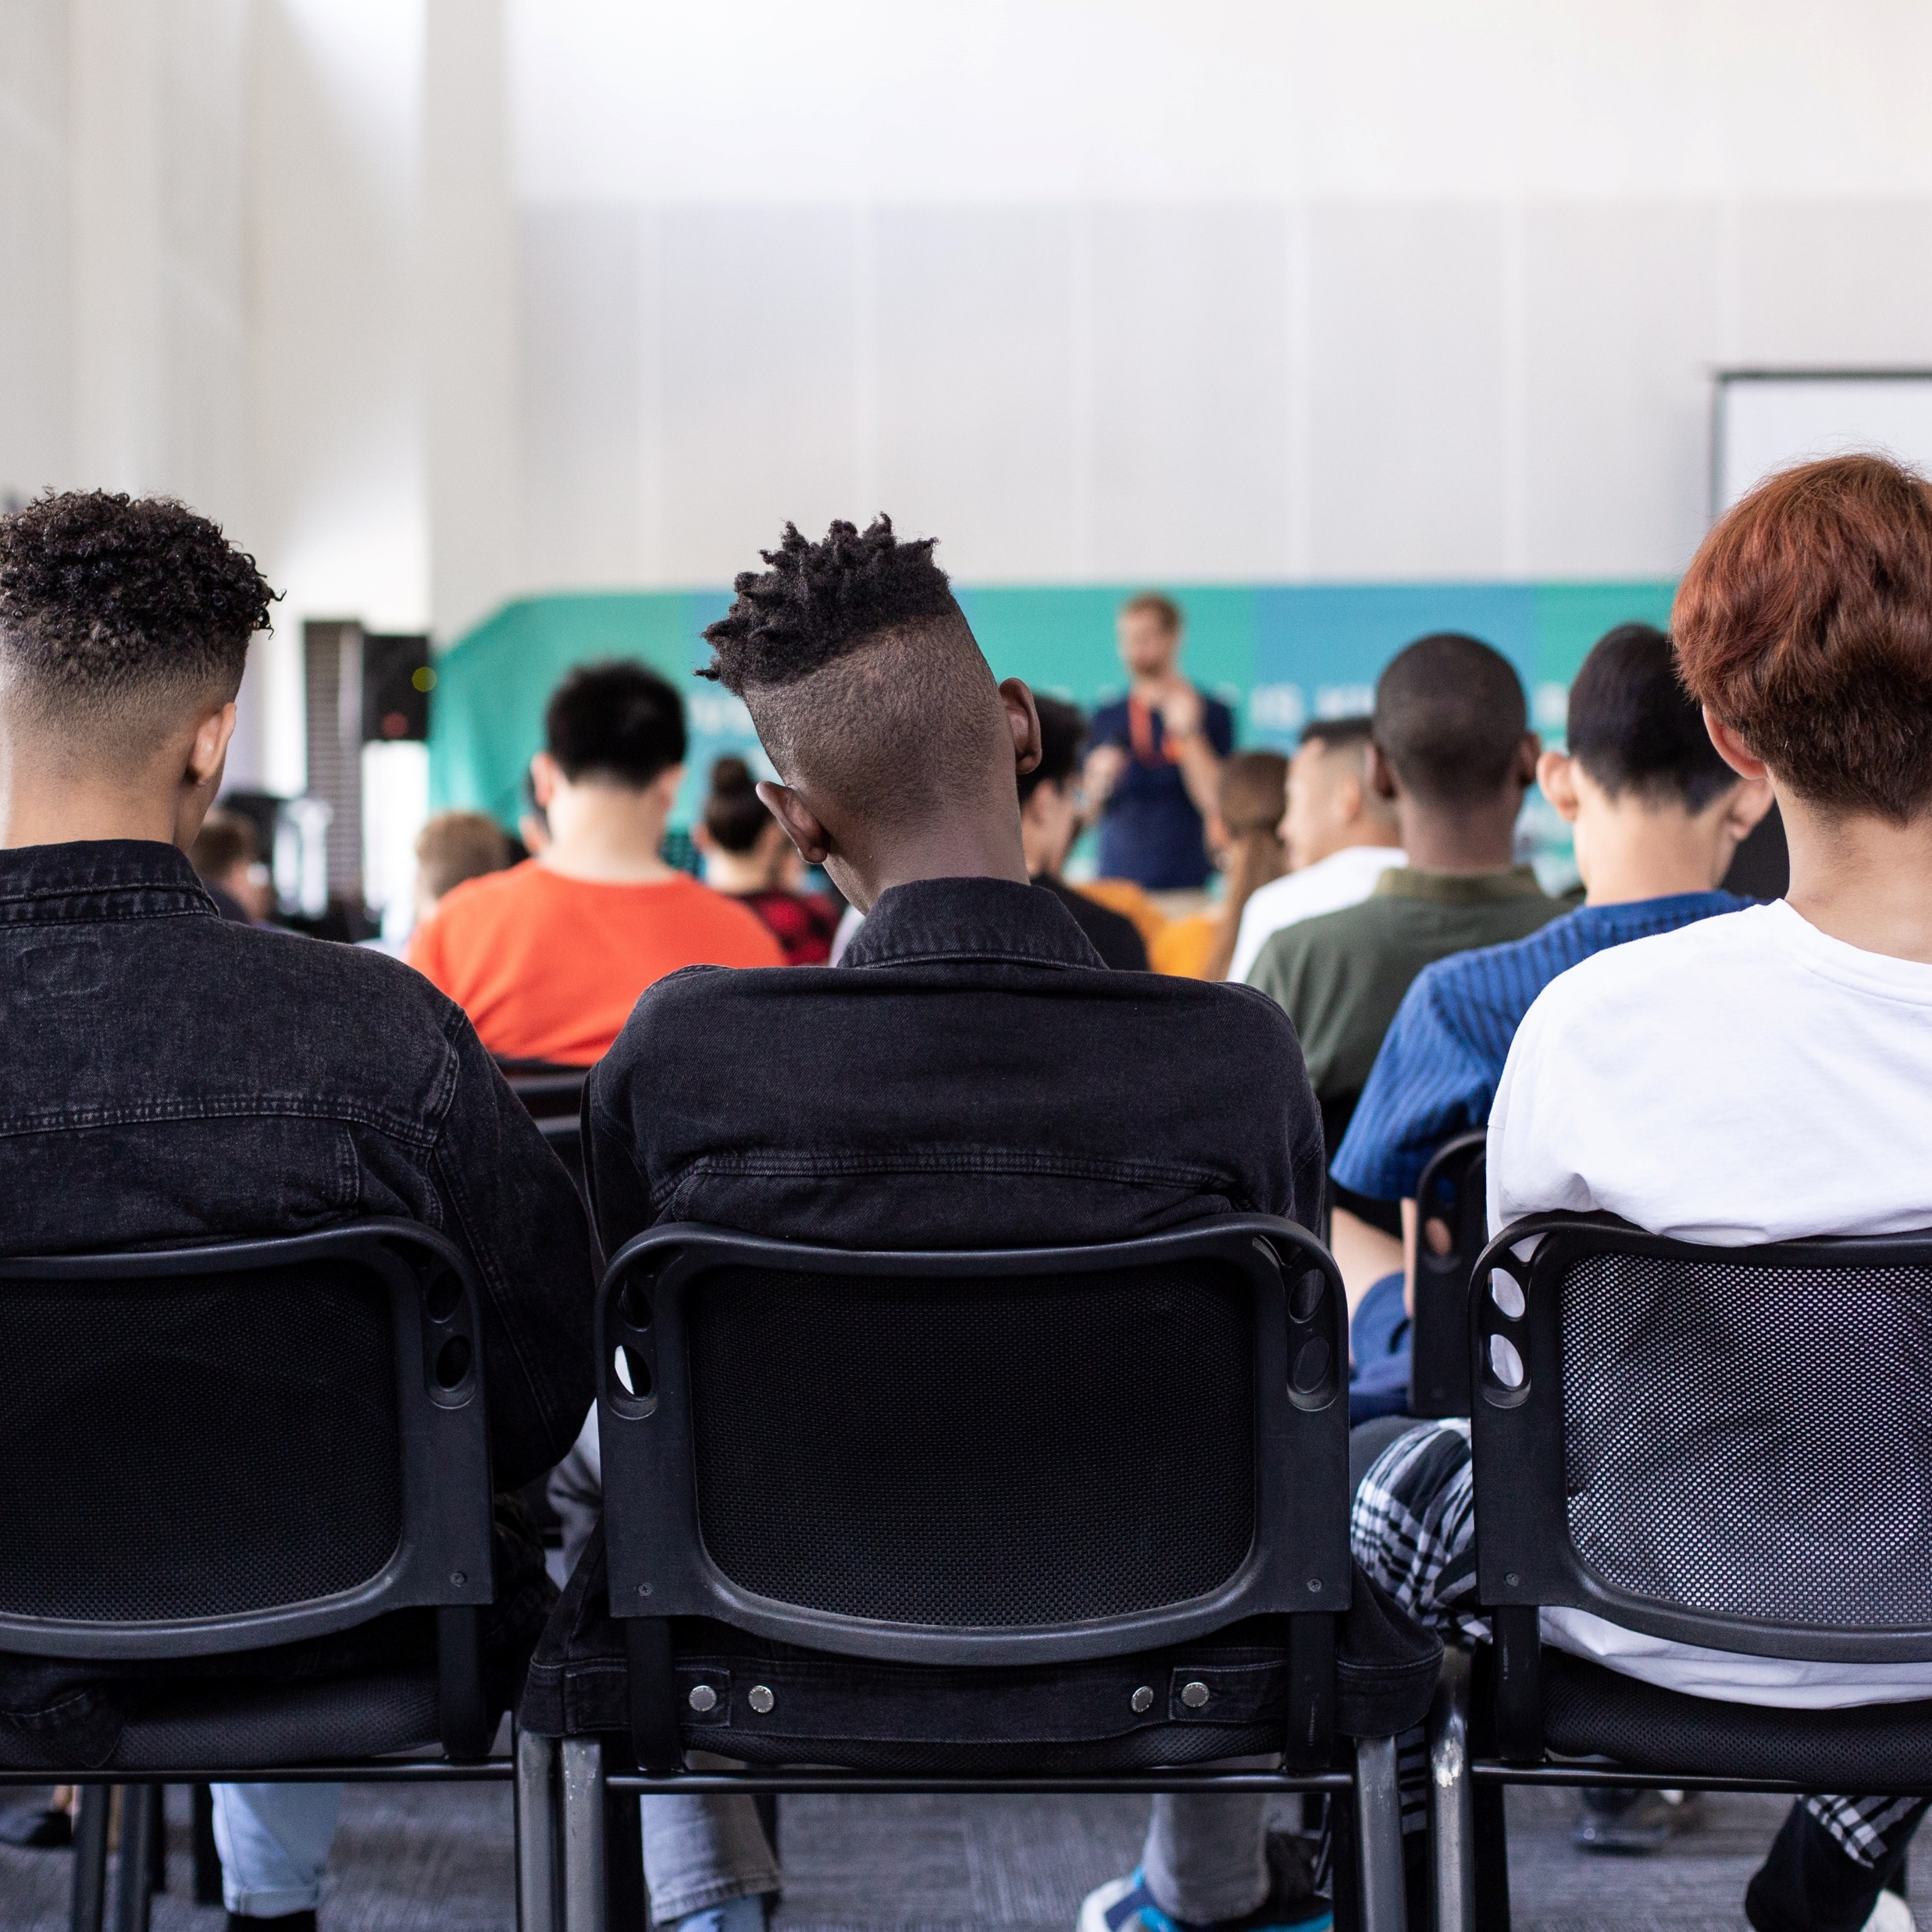
Issues of last term
Our mental health and wellbeing
Climate and the environment
Education and the school curriculum

Slide 7
Your task – what are your priorities as a school council?
This is a task that the Welsh Youth Parliament do early on in their term to decide upon their next steps:
You should choose
- a Secretary
- a Chair in each group
Complete the sheet to discuss your priorities as a school council.
Once you have completed this, write down one step you would like to see the council/ school Senedd take in the next few months.
Notes:
With this task – it’s worth emphasizing prior to election that there is scope to create a manifesto a prepare ideas with conviction and write persuasively etc. Tasks of the sort are helpful to model the concept of school councils which would be useful: the Welsh Youth Parliament get elected, they then choose topics of importance, through an election, then they create Committees– similar to Senedd Committees. Similar tasks help to coordinate group visions or smaller committees and help focus the mind of the group to choose relevant topics to the group themselves to assist them knowing what they are doing and where they are going.

Slide 8
Further inspiration
Watch a clip from the Welsh Youth Parliament talking about the topic of Climate Change for inspiration: https://www.youtube.com/watch?v=YBsKFt9Bvo4
Notes:
https://www.youtube.com/watch?v=YBsKFt9Bvo4 Show pupils the clip - aa good way of inspiring young people and showing them that other young people do similar things to them.

Slide 9
It’s debatable
“We should provide an opportunity for all 11-18 year olds to attend a free outdoor residential course in Wales.” Agree/ Disagree

Slide 10
Devolved topics
Food
Ancient Monuments
Tourism
Education
Farming
Fire and rescue services
Sports and Leisure
Welsh language
Environment
Housing
Mental Health Services
Healthcare
Water
Equality

Slide 11
How can you have a voice in the community?
School council/ Senedd
Committees
Campaigns/ election
Remember Article 12 of the UNCRC (Rights of the Child):
“ Young people and children have a right to have their voices heard.”
Petitioning
Email your Member of the Senedd
Welsh Youth Parliament
Visit the Senedd
Voting

Slide 12
Discussion
Chair to lead a discussion summarising the session and giving opportunities for everyone to mention any other matter.

